Slide 1
Android Phone Security
Jake Ellis
Michael Colliver
Cory Hatter

Slide 2
Summary
Introduction
Phone rooting
Brute force example
Protecting android phones
Notes:
Rooting: Learning experiences with rooting the emulator, the phone, installing the app and creating the app.
Rooting means: unlocking the powers of your DROID that would not specifically be allowed from the provider.

Slide 3
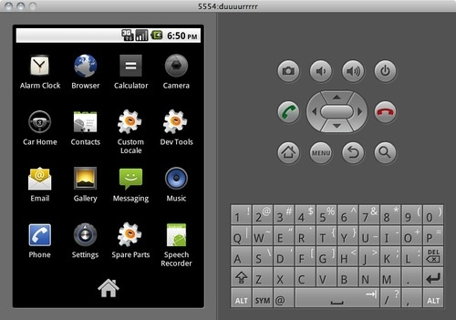
Rooting Android
Version 2.2
Superuser access
Change read-only files

Slide 4
Rooting (cont.)
Advantages
Battery life
Ergonomic keyboard
Bonus apps
Free tethering
Move cache data
Disadvantages
Warranty void
Risk of damage
Less secure

Slide 5
Brute Force Example
APP

Slide 6
Application Protection
Free phone security apps:
Lookout Mobile Security (Free and Premium)
Norton Mobile Security Beta (Free)
WaveSecure Mobile Security (Subscription)
AVG Antivirus (Free)
NetQin Antivirus (Free)

Slide 7
Common Sense Tips
Password protect
Customize home screen
Use official android market
Disable unused wireless networks
Update OS
Be wary of public networks

